Slide 1
Tools of Science
Notes:
Everyday

Slide 2
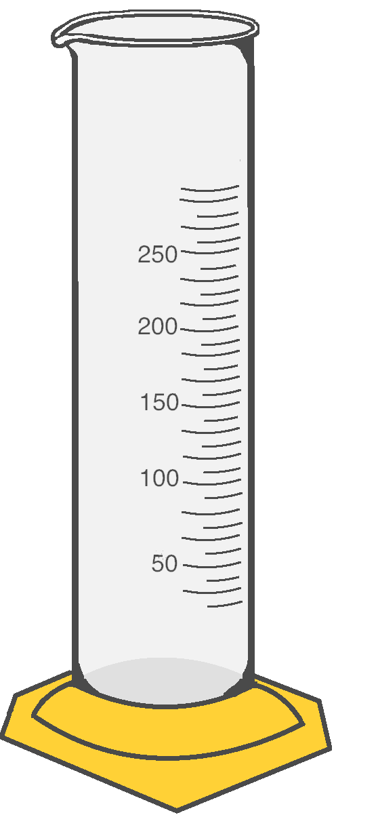
Volume
Metric System (SI) Units for Volume:
1 Liter (L) = 1000 Milliliters (mL)
1 Milliliter (mL) = 1 Cubic Centimeters (cm³)
Volume is the amount of three-dimensional space something takes up.
The Base Unit for Volume using the Metric System (SI) is Liter.
Solids, liquids, and gases all have volume.
Volume is measured differently for solids, liquids, and gases
U.S. Customary Units to the Metric System (SI):
1 Gallon (G) = 3.78541 Liters (L)
1 Tablespoon (tbsp) = 14.7868 Milliliters (mL)
Graduated Cylinder
Notes:
If kids

Slide 3
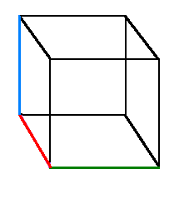

Length
Metric System (SI) Units for Length:
1 Kilometer (km) = 1000 Meters (m)
1 Meter (m) = 100 Centimeters (cm)
1 Centimeter (cm) = 10 Millimeters (mm)
Length is used to measure distances.
The Base Unit for length using the Metric System (SI) is Meter.
Length can describe the dimensions of an object (length, width, height) or can describe the distance between two objects.
U.S. Customary Units to the Metric System (SI):
1 Inch (in) = 2.54 Centimeters (cm)
1 Foot (ft) = 0.3048 Meters (m)
1 Mile (mi) = 1.60934 Kilometers (km)
Dimensions
Volume =
Length x Width x Height
Height
Width
Meter Stick
Length

Slide 4
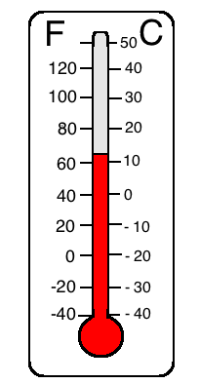
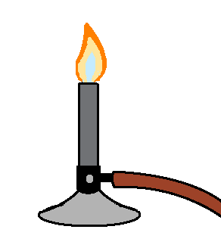
Metric System (SI): Celsius
Temperature
Freezing point = 0° C
Boiling point = 100° C
Temperature is used to describe the amount of heat energy present or the lack of heat energy in an environment (how hot or cold something is).
In the Metric System (SI), we measure temperature using degrees Celsius.
There are Freezing Points and Boiling Points in temperature scales:
Freezing Point: the temperature where water becomes a solid
Boiling Point: the temperature where water evaporates (becomes a gas).
U.S. Customary: Fahrenheit
Freezing point = 32° F
Boiling point = 212° F
Bunsen Burner:
Used to heat substances in a laboratory setting
Thermometer:
Used to measure temperature of the environment

Slide 5
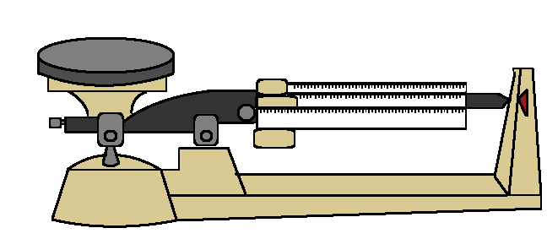
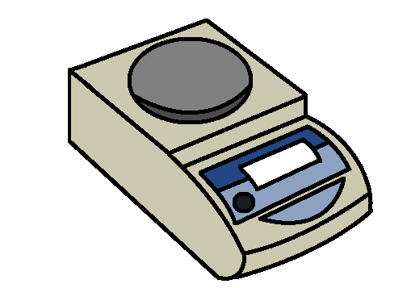
Weight and Mass
Metric System (SI) Units for Length:
1 Kilogram (kg) = 1000 Grams (g)
1 Gram (m) = 1000 Milligrams (mg)
Weight is the measure of the downward force of an object due to gravity and is used to find an object’s Mass.
The Base Unit for mass using the Metric System (SI) is the Kilogram.
We use Scales to weigh objects. However, scales are set to give you the object’s mass and not the object’s weight.
U.S. Customary Units to Metric System Units (SI):
1 Pound (lb) = 0.453592 Grams (g)
1 Ounce (Oz) = 28349.5 Milligrams (mg)
Some of the Tools Used to Find Mass and Weight:
0.00
Scale
Triple Beam Balance

Slide 6
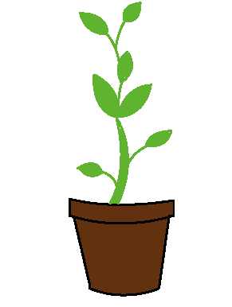

Quantitative Values
A Quantitative value is any value that can be measured using units.
This is any type of data that has a number value. This type of data uses units that express length, mass, volume, etc.
Instead of saying Plant B is taller than Plant A, a Quantitative value would be:
Plant A is 9 centimeters (cm) tall and Plant B is 12 centimeters (cm) tall.
Plant A:
9 cm
Plant B:
12 cm
Number value
Unit

Slide 7


Qualitative Values
A Qualitative value is any value that can NOT be measured using units.
This type of data uses descriptions that express change in things like color, consistency, smell, and texture.
For example, we noticed that Plant A grew more leaves than Plant B.
There are no number values OR units when making a qualitative observation.
Plant A:
Has less leaves
Plant B:
Has more leaves

Slide 8
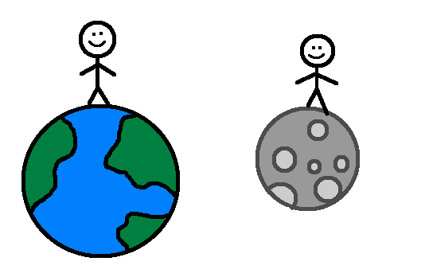
Weight vs. Mass
You would weigh about 16.6 pounds on the moon!
If I weigh 100 pounds on Earth, I wonder what I would weigh on the moon?
Weight and Mass are not the same thing:
Mass is how much matter an object or substance contains.
Weight is the Mass of an object combined combined with the force of gravity pressing down on that object.
Balances or scales are used to find the weight of an object. Then, the Weight is used to calculate the object’s Mass.
If you were on the moon, you would weigh less (because there is no gravity) but you would still have the same mass.

Slide 9

U.S. Customary vs. the Metric System (SI)
In America, we use a system of measurement called U.S. Customary Units, which include miles, pounds, and cups. In the scientific community, all countries use the International System of Units (SI) for their data, which include kilometers, grams, and liters.
When scientists design experiments, they have to be designed so that anyone who reads their procedures (directions) can repeat the same experiment. Imagine how difficult it would be for scientists if every country used a different system of measurement! That is why all countries (including the U.S.) use the SI system for measurement when they are working in the field of science!

Slide 10
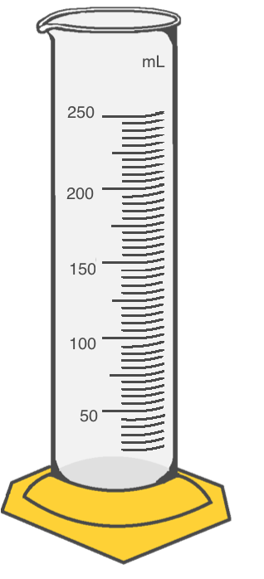


Displacement
Finding Volume:
Displacement helps us find the volume of an object.
To find this volume, we fill a graduated cylinder with a certain amount of water (let’s say 50 L). Then, an object is placed in the graduated cylinder and the water rises (let’s say it rises to 150 L).
We can see that our object had a Volume of 100 L. Since no additional water was added, we know that the amount the water rose is the volume of the object we placed in the water!
150 L – 50 L = 100 L
150 L
50 L

Slide 11
Units and Conversions
In America, we use a system of measurement called U.S. Customary Units. However, in the scientific community, everyone uses the International System of Units (SI) for their data.
The SI units are used worldwide to help scientists from all different countries and languages understand one another’s experiments.
SI Units | Conversion | U.S. Customary Units
Meters (m) | Multiply by 3.28084 | Feet (ft)
Centimeters (cm) | Multiply by 0.3937 | Inches (inch)
Kilometers (km) | Multiply by 0.621371 | Miles (mi)
Gram (g) | Divide by 453.5924 | Pounds (lb)
Kilogram (kg) | Multiply by 2.294623 | Pounds (lb)
Liters (L) | Multiply by 0.264172 | U.S. Gallon (gal)

Slide 12



Slide 13
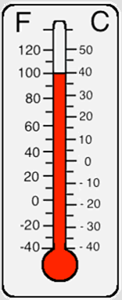
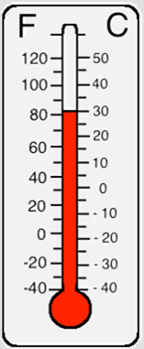
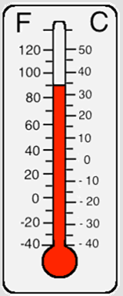
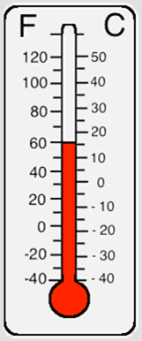
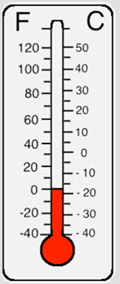
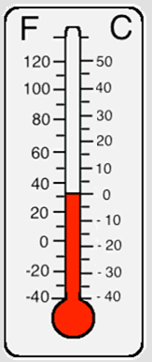

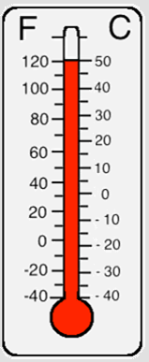

Slide 14



Slide 15
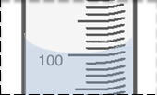

The meniscus is the U-shaped curve that the water makes at the top of the liquid.
To find the volume, we look at the bottom of the meniscus and read the line that it touches.
(This is 100 mL)

Slide 16
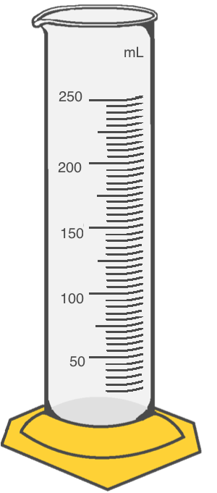

Slide 17
Notes:
100 to 225

Slide 18
Notes:
150 to 215

Slide 19

Notes:
185 to 210

Slide 20

Notes:
80 to 235

Slide 21

Notes:
170 to 230

Slide 22

Notes:
95 to 175

Slide 23
Notes:
200 to 240

Slide 24
Notes:
50 to 200

Slide 25
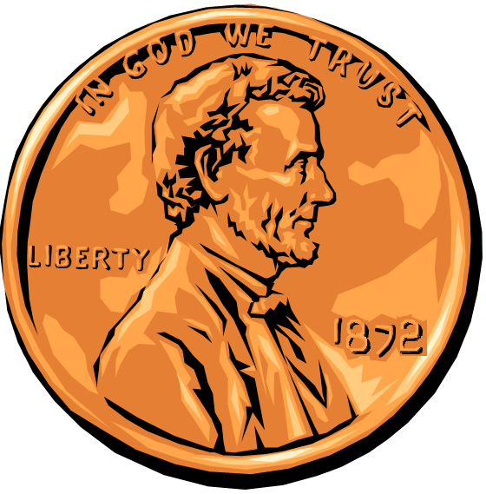
Notes:
155 to 220

Slide 26

Notes:
90 to 245

Slide 28
Volume = L × W × H
Volume = 6 cm × 4 cm × 5 cm
Volume= 120 cm³
H = 5 cm
W = 4 cm
L = 6 cm
r = 2 cm
π = 3.14
r
Volume = π × r² × H
or Volume = π × r × r × H
Volume = 3.14 × 2 cm × 2 cm × 4 cm
Volume= 50.24 cm³
H = 4 cm

Slide 29
10 cm
10 cm
5 cm

Slide 30
8 cm
2 cm
3 cm

Slide 31
r = 5 cm
h = 2 cm

Slide 32
5 cm
5 cm
5 cm

Slide 33
r = 1 cm
h = 7 cm

Slide 34
4 cm
20 cm
4 cm

Slide 35
r = 2 cm
h = 5 cm

Slide 36
2 cm
2 cm
2 cm

Slide 37
6 cm
1 cm
6 cm

Slide 38
r = 8 cm
h = 10 cm

Slide 39
r10° C x 9 = 90°
90° ÷ 5 = 18°
18° + 32 = 50° F
r5° F – 32 = – 27
– 27° x 5 = – 135°
-135° / 9 = -15° C
30°C x 9 = 270°
270° ÷ 5 = 54°
54° + 32 = 86° F
5° C x 9 = 45°
45° ÷ 5 = 9°
9° + 32° = 41°
0° C x 9 = 0°
0° ÷ 5 = 0°
0° + 32 = 32° F
r100°C x 9 = 900°
900° ÷ 5 = 180°
180° + 32 = 212°F
r60°C x 9 = 540°
540°÷ 5 = 108°
108° + 32 = 140°F
32° F – 32 = 0°
0° x 5 = 0°
0° / 9 = 0° C
r20°C x 9 = 180°
180° ÷ 5 = 36°
36° + 32 = 68°F
r23° F – 32 = – 9°
– 9° x 5 = – 45°
– 45° / 9 = -5° C

Slide 40
C to F
20°C x 9 = 180°
180° ÷ 5 = 36°
36° + 32 = 68°F
30°C x 9 = 270°
270° ÷ 5 = 54°
54° + 32 = 86° F
40°C x 9 = 360°
360°÷ 5 = 72°
72° + 32 = 104°F
50°C x 9 = 450°
450° ÷ 5 = 90°
90° + 32 = 122°F
F to C
5° F – 32 = – 27
– 27° x 5 = – 135°
-135° / 9 = -15° C
14° F – 32 = – 18°
– 18° x 5 = 90°
90° 9 = 10° C
23° F – 32 = – 9°
– 9° x 5 = – 45°
– 45° / 9 = 5° C
95°F - 32° = 63°
63° × 5 = 315°
315° ÷ 9 = 35°C
5° C x 9 = 45°
45° ÷ 5 = 9°
9° + 32° = 41°
10° C x 9 = 90°
90° ÷ 5 = 18°
18° + 32 = 50° F
60°C x 9 = 540°
540°÷ 5 = 108°
108° + 32 = 140°F
70°C x 9 = 630°
630° ÷ 5 = 126°
126° + 32 = 158°F
80°C x 9 = 720°
720° ÷ 5 = 144°
144° + 32 = 176°F
90°C x 9 = 810°
810° ÷ 5 = 162°
162° + 32 = 194°F

Slide 41
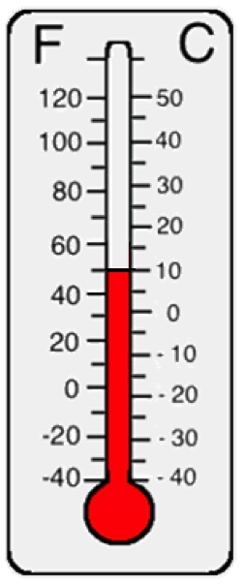

As the temperature goes up, the level of the red liquid (often Mercury or an Alcohol) rises. To read the temperature, look at the top of the red liquid.
The left side is Fahrenheit. The markings occur every 10 °F on this thermometer.
The right side is Celsius. The markings occur every 5 °C degrees on this thermometer.

Slide 42



